Slide 1

A 21st Century Analysis of the Ashes (2002-2025)
Programming for Data Science Assessment

Slide 2
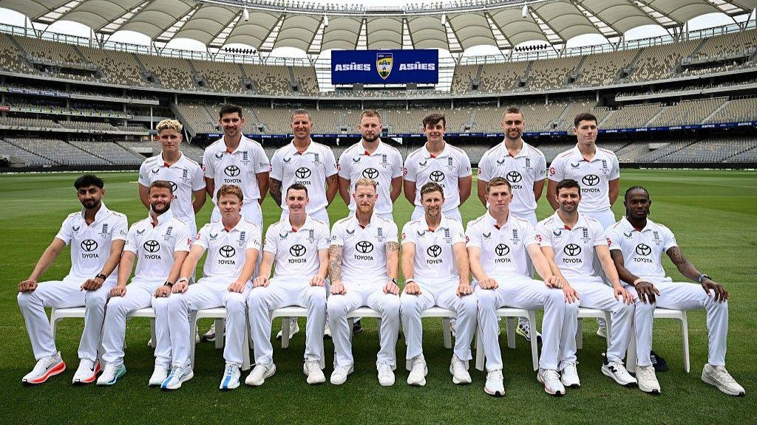
What Are The Ashes?
Australia vs England
Over 140 year rivalry between the two countries.
Five Match Test Series
Each test takes roughly five days with four innings.
Takes Place Roughly Every 2 Year
Alternates different host country.
Figure 1. England men’s cricket team (BBC Sport, 2025)
Notes:
Give an outline of what the Ashes series is.

Slide 3
Data taken from Cricsheet
Provides ball by ball data of each Ashes test match.
Chosen Dataset
Large dataset
Matches from 2002/03 series to 2025/26 series taken and complied into a large dataframe.
Missing matches
Excludes first 3 matches of 2002/03 series and last 3 matches of 2005 series since they are not available.
Notes:
Describe the data that was used.
Data taken from cricsheet.org .
59 matches from 2002 to 2025 read into code using a loop.
Each match provides ball by ball data.
Extra columns added for extra information leading to a data frame size of 113169 rows x 38 cols.
Data from website excluded the first three matches from 2002/03 series and last there from 2005 series.

Slide 4
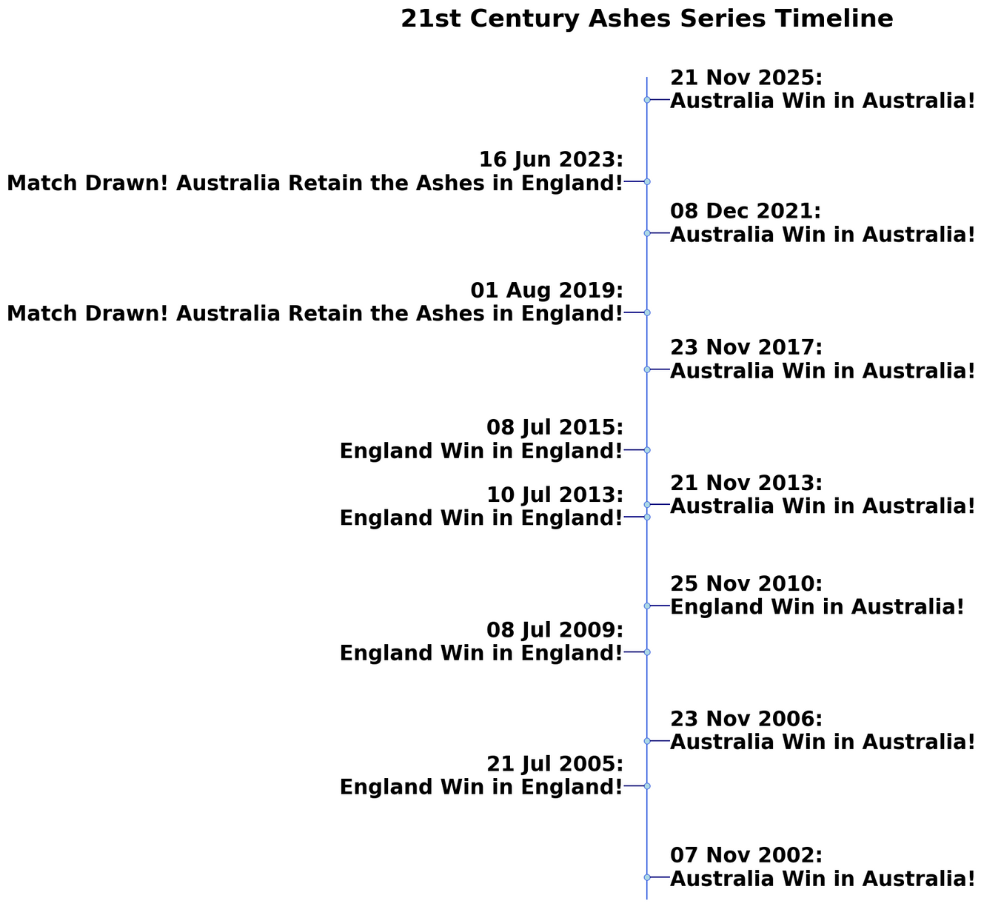
Timeline of Dominance
Australia have dominated the game in last 10 years
Ashes Retained by Australia
Notes:
Describe history from 2002 to 2025.
Since 2002 England have won 5 series, Australia have won 6 series and 2 series have been drawn.
Since 2017 Australia have retained the Ashes.

Slide 5
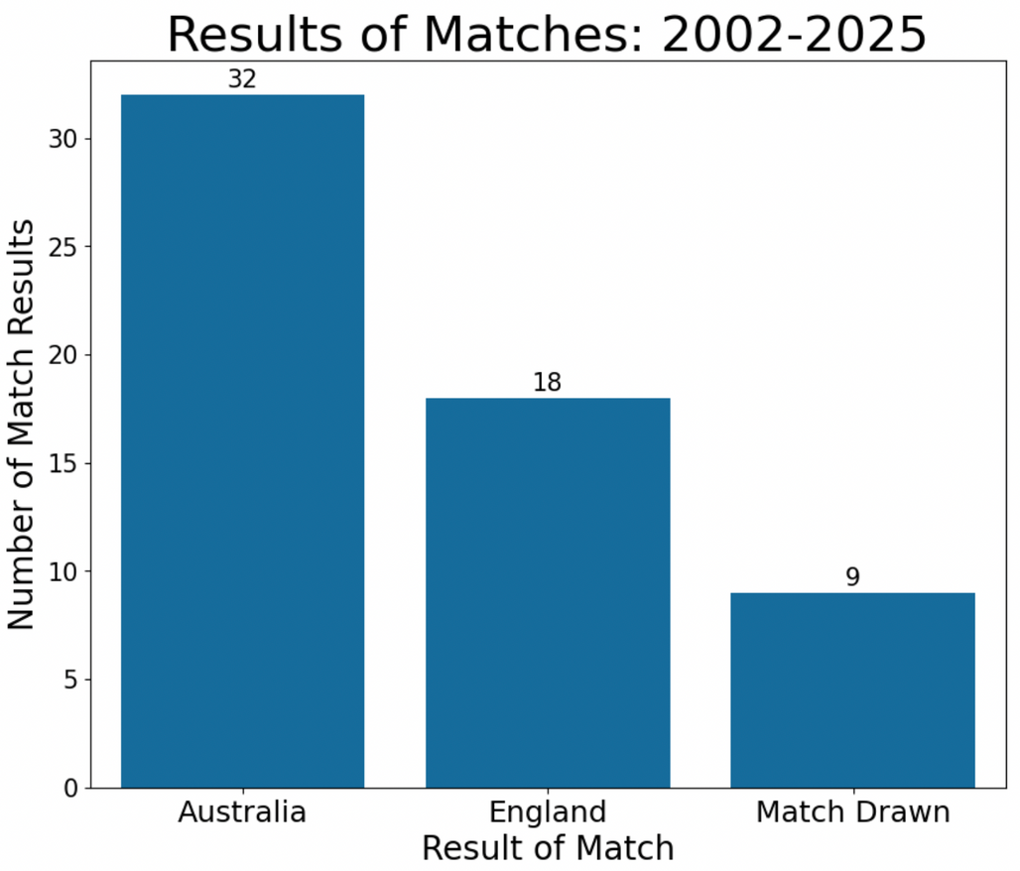
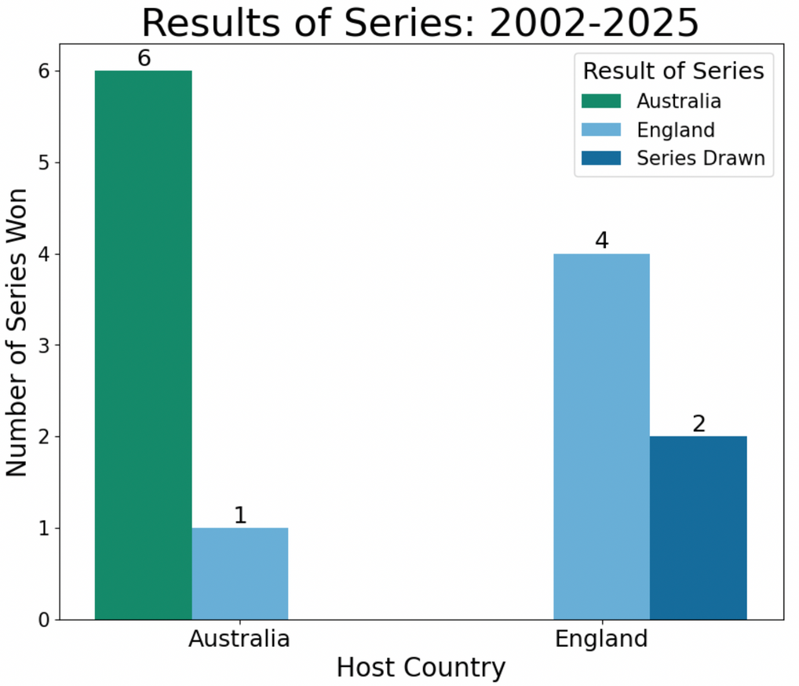
Series and Match Results
Notes:
Describe both plots.
Barplot on the left shows the number of matches each team has won since 2002.
Barplot on right shows the number of series each team has won and where each win took place.

Slide 6
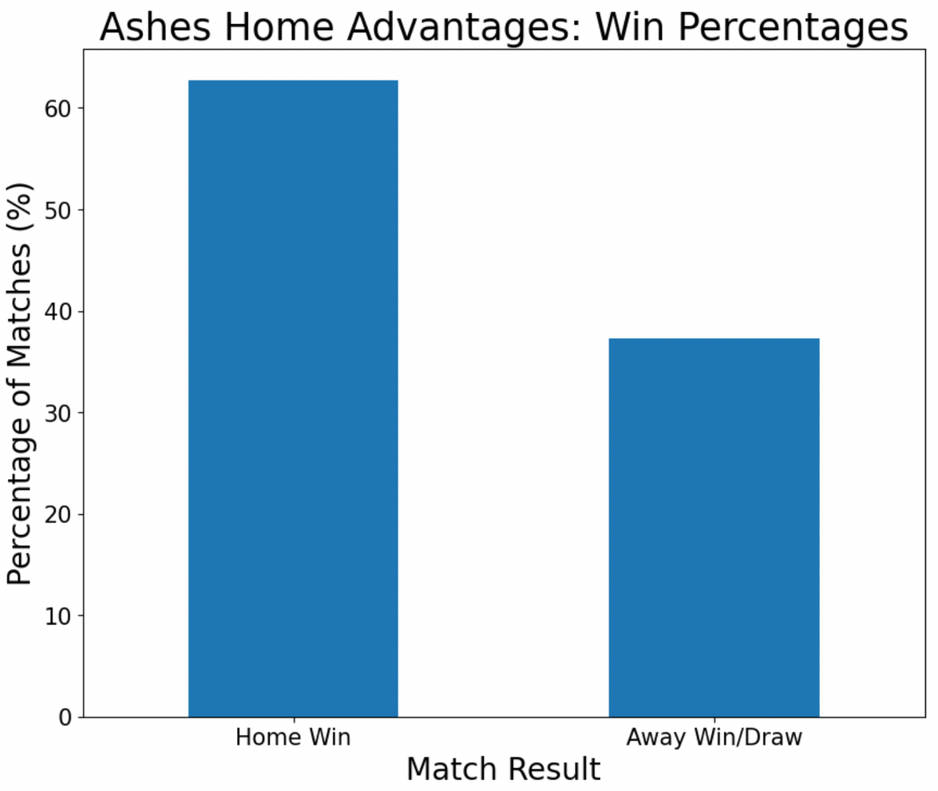
Is There a Home Advantage?
63% of matches won at a home ground
Binomial test gave P-Value of 0.0337
Statistically significant: There is a home advantage
Notes:
There should be a 50:50 ratio of home vs away wins.
In actual fact, this is 63:37.
A binomial test gave a p value of 0.0337.
Statically significant that there is a home advantage.
Some reasons that could be mentioned about why there might be a home advantage:
Pitches all perform differently-
Australian pitches have a higher bounce than English pitches.
In England the ball swings away more.
Depending on weather the ball can grip and spin more on dry surfaces (Australia and England have different climates).
Influence of Fans- Barmy Army has a huge presence in English cricket.

Slide 7
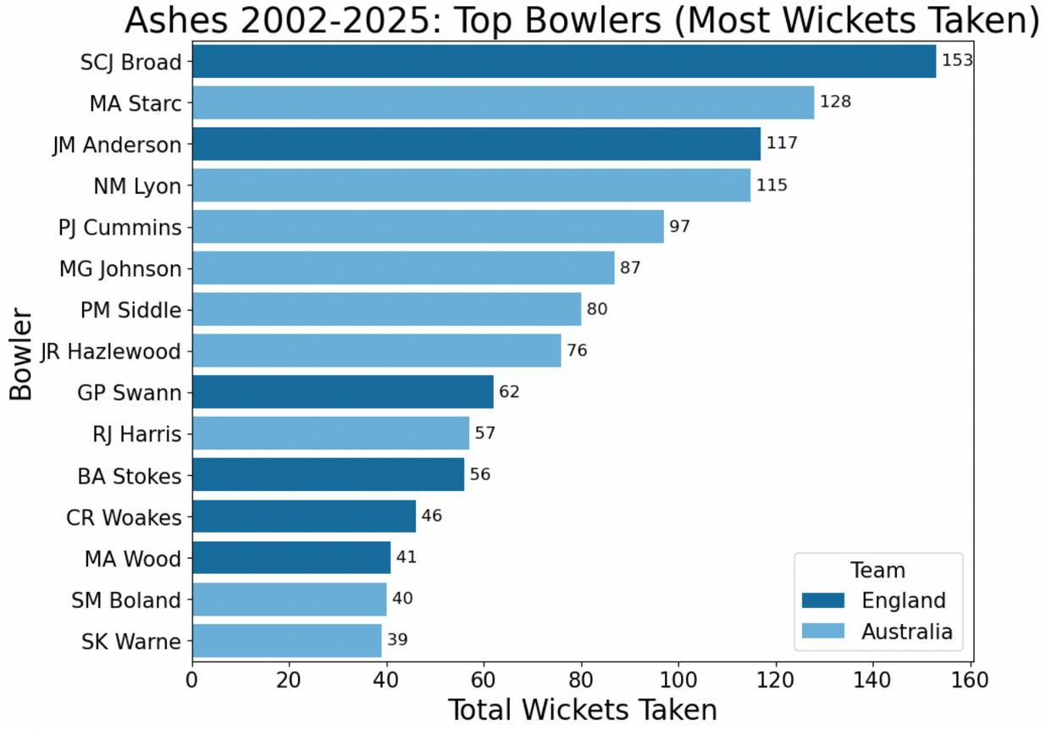
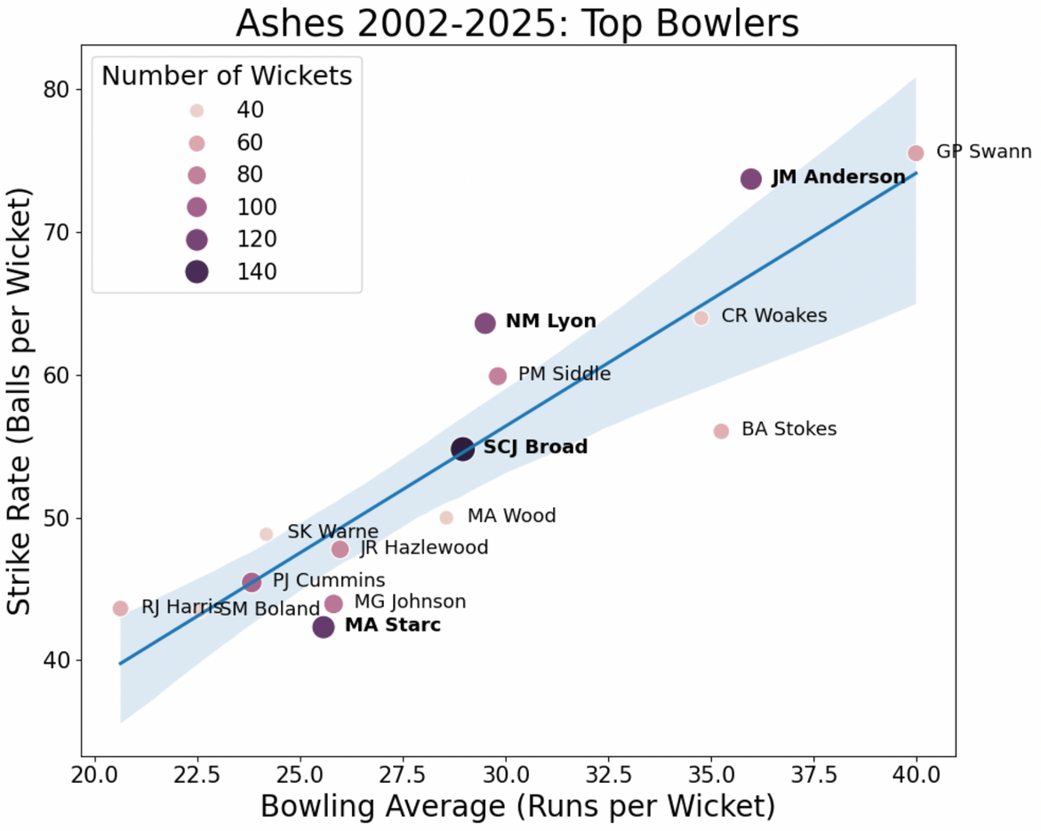
Who Are The Top Bowlers?
r-value: 0.899
Notes:
Plot on left:
Shows which bowlers from 2002 to 2025 have taken the most wickets, coloured by team.
Stuart Broad has taken the most with a total of 153.
Plot on right:
Shows the strike rate (balls/wickets) vs bowling average (runs/wickets).
Strong positive linear correlation with a r value of 0.899.
Coloured and sized by number of wickets.
The lower strike rate and bowling average the better the bowler.
From the graph it could be argued that Motchell Starc is the best bowler, with the lowest strike rate, a high amount of wickets and a low average.

Slide 8
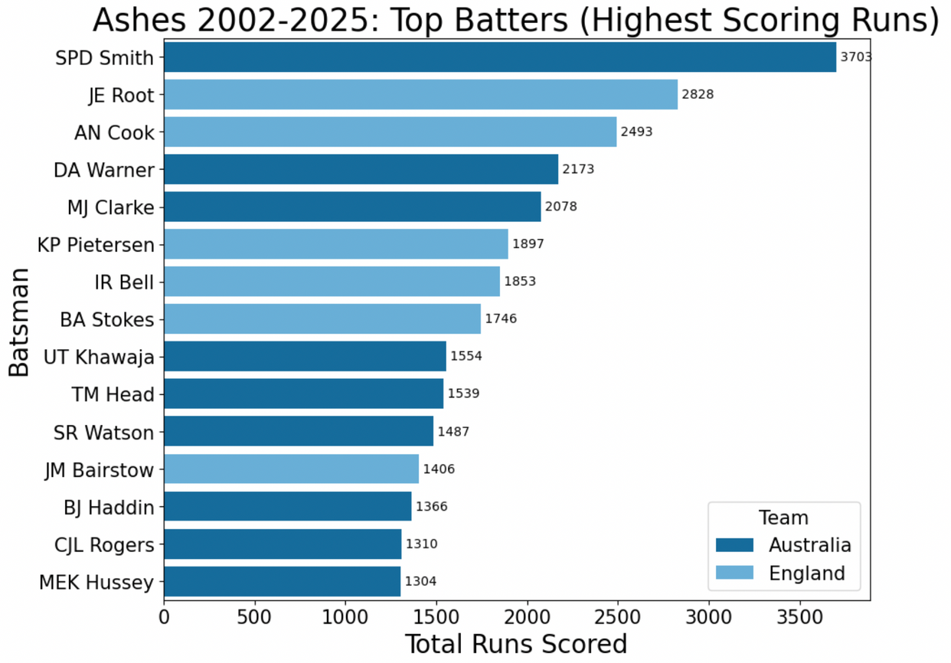
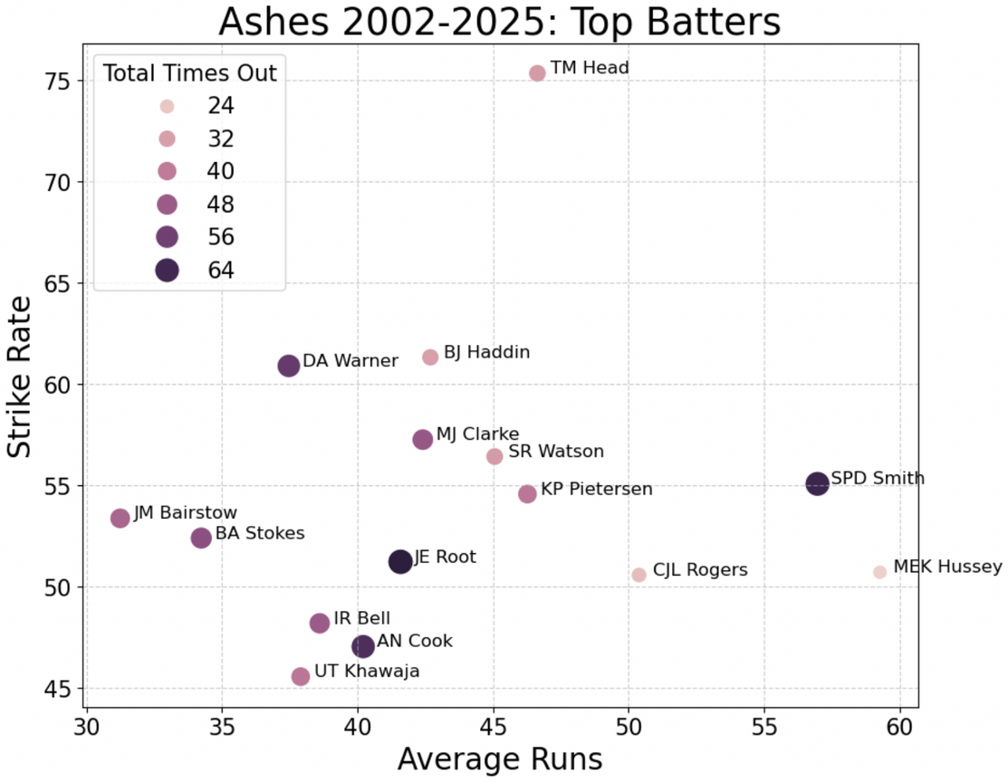
Who Are The Top Batters?
Steve Smith has scored the most runs between 2002-2025
Travis Head has the highest strike rate.
Notes:
Plot on the left:
Shows the strike rate (total runs/ balls) vs average runs (total runs/ times out).
Coloured and sized by number of times out.
The higher the strike rate and average runs the better.
Travis Head has the highest strike rate, influential of the most recent series where he scored three centuries.
Plot on the right:
Shows the batters with the highest total runs scored from 2002 to 2025, coloured by team.
Steve Smith has scored the most runs with 3703 runs.

Slide 9
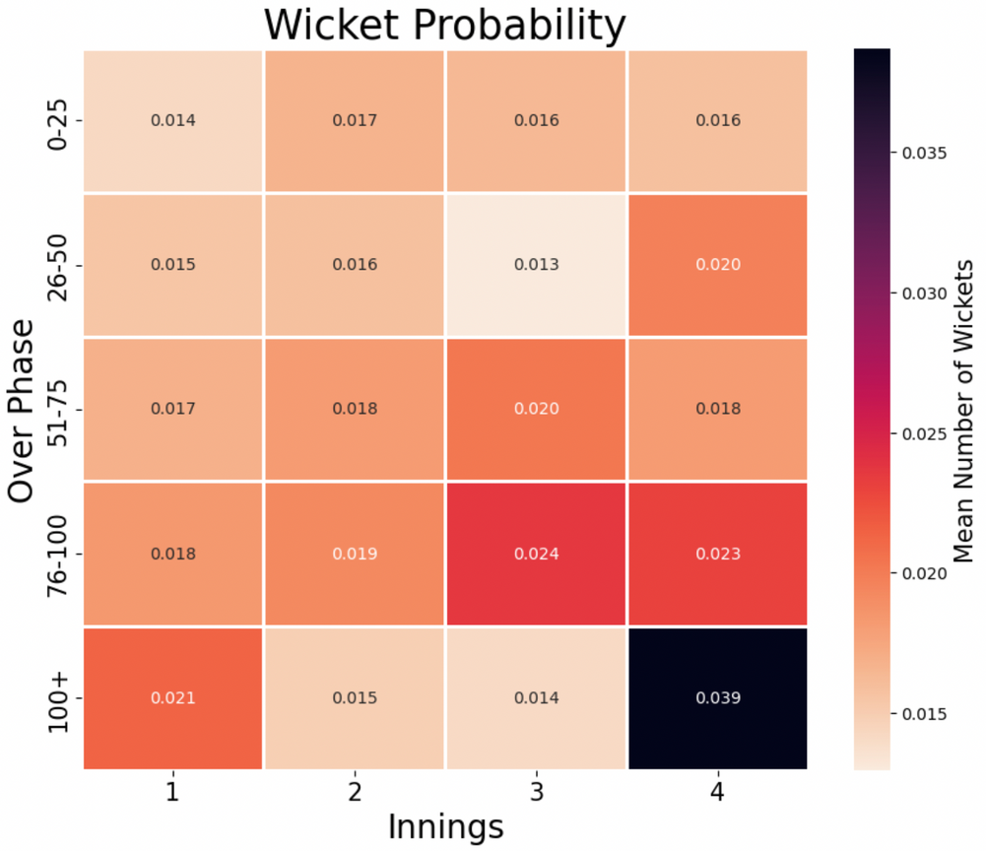
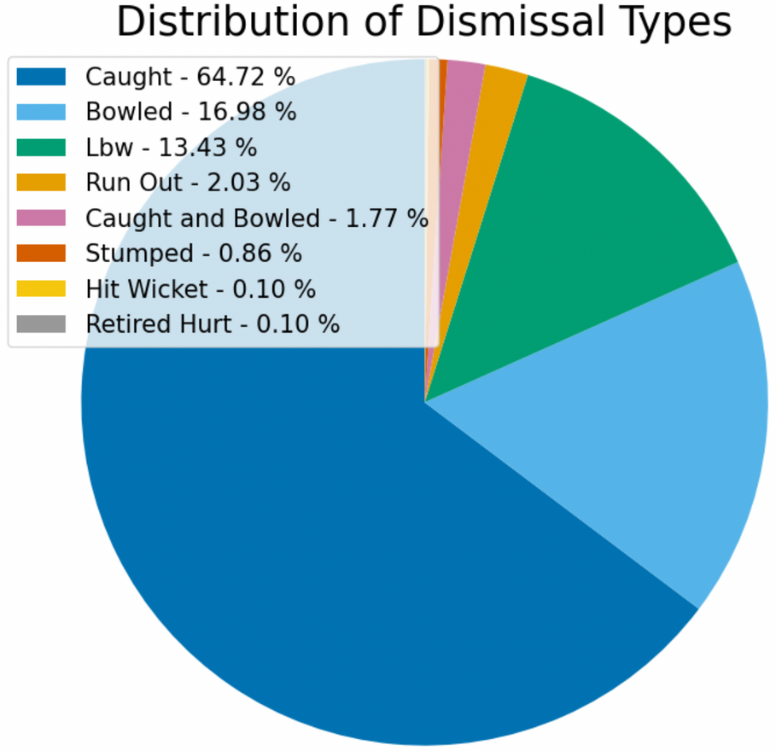
Anatomy of Wickets
4th Innings after 100+ overs is the most dangerous
Most wicket type is caught
Notes:
Plot on the left:
Pie plot shows the distribution of dismissal types.
Caught is the most common way the get out and retired hurt is the least common.
Plot on the right:
Heatmap shows the probability of wickets in each innings in different over phases.
After 100 plus overs in the 4th innings has the highest mean number of wickets.
Between 76-100 overs has overall the highest number of wickets per innings.
This will be because after the 80th over a new ball is given, which can move on the pitch a lot more, leading to more dismissals.

Slide 10
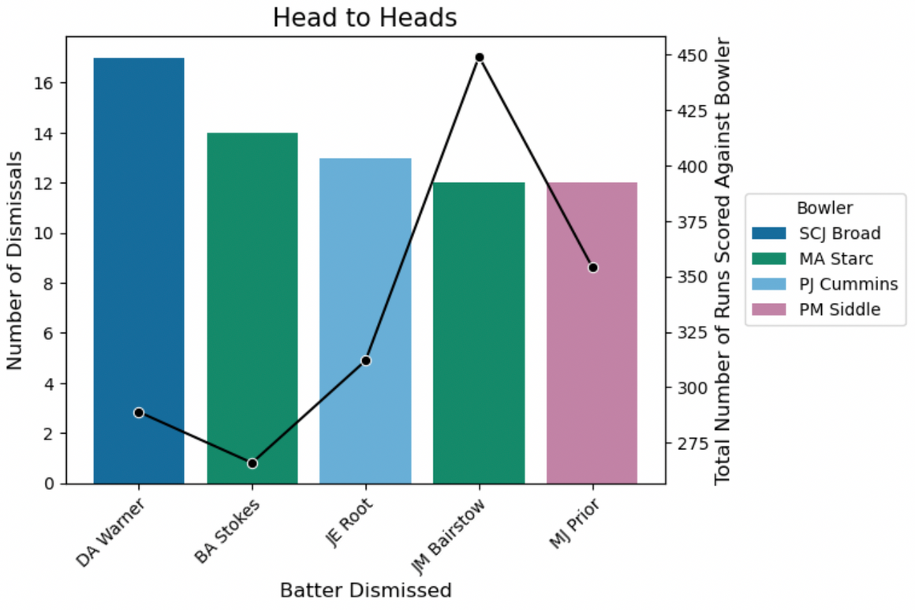
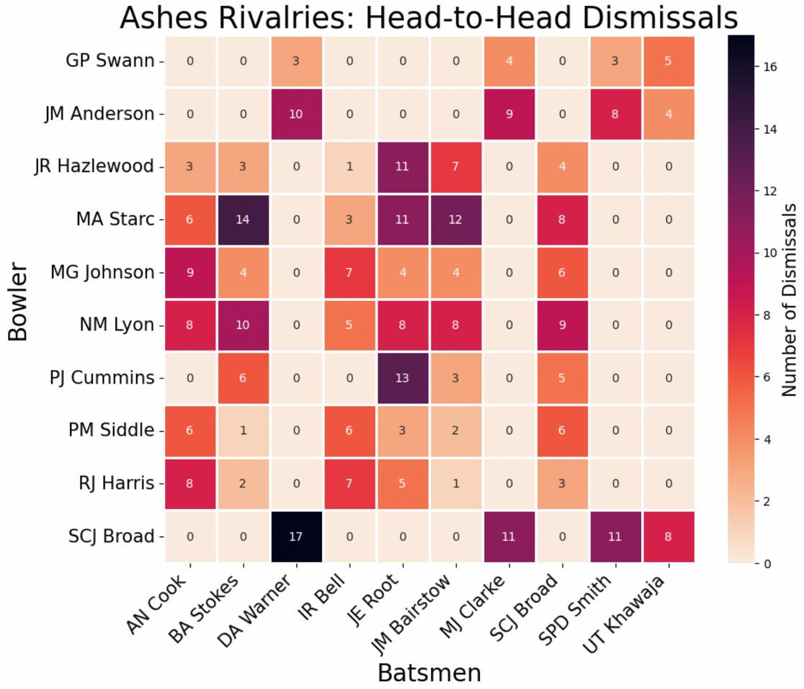
Stuart Broad has dismissed David Warner 17 times!
Does a Bowler Own a Batter?
Notes:
Plot on the left:
Shows the number of dismissals a specific bowler has taken against a specific batter and the number of runs in total that batter has scored against that bowler.
David Warner has been dismissed by Stuart Broad 17 times. Mitchell Starc has dismissed both Ben Stokes and Johnny Bairstow 14 and 12 times.
Plot on the right:
Heat map that shows the top 10 batters and top 10 bowlers coloured by the number of dismissals.

Slide 11
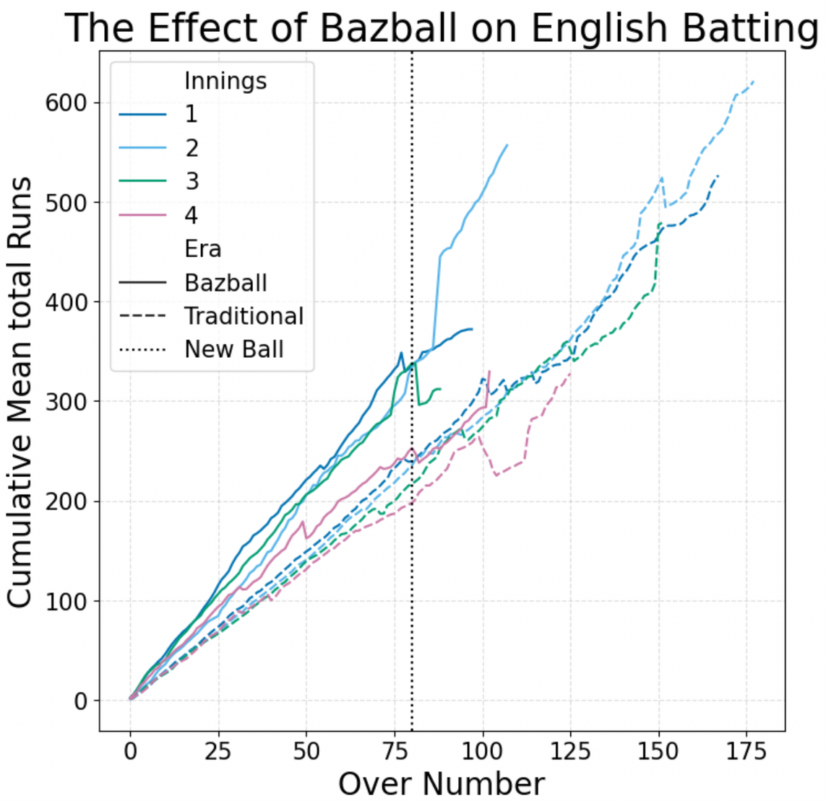
The Effect of “Bazball”
Introduced in 2022 by coach Brendon "Baz" McCullum
Agressive style of test cricket that forces results, rather than playing defensively
Notes:
Bazball is a more aggressive style of test cricket introduced by England coach Brendon McCullum in 2022.
The approach is highly controversial.
It forces results when batting rather than playing defensively like in tradition test cricket.
The line plot shows the increase in cumulative mean runs as the over progress for each od the 4 innings.
The solid line shows the effect of bazball. It has an increased run rate compared to traditional, however has a shorter stop off, with innings not reaching the higher overs or runs.
The dotted line indicates the new ball at 80 overs.
After the new ball is introduced, you can see a slight decrease in the number of runs. Meaning more dismissals and a slower run rate because the ball is doing more.

Slide 12
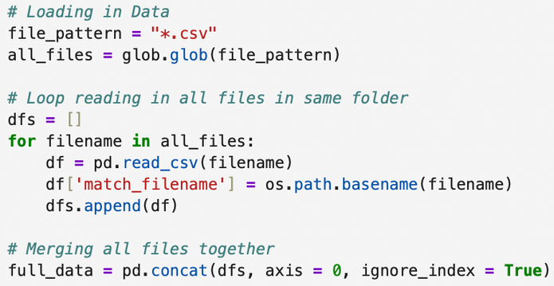
Critical Evaluation
Challenges with data:
Improvements
An incomplete dataset made manipulating data necessary.
A loop was required to read in all CSV files and to merge them together.
Improve pie plot by merging those with small percentages into an “other” section.
Investigate the effect of “Bazball” further: look at the effect on bowling and the Australian team.
References
BBC Sport (2025) England v India: First Test, day one - live [Photograph]. Available at: https://www.bbc.co.uk/sport/cricket/live/cz0xkxkx8g2t (Accessed: 15 January 2026).
The use of GIT. Branches weren’t needed, however accidently created one.
Notes:
A few challenges were faced when using this dataframe:
The data had missing matches making all comparisons slightly wrong and harder to plot.
To overcome this, the man in charge of the website was emailed and he provided me with two of the matches from 2005, which weren’t originally available however didn’t have the rest.
Each match was in a separate csv file meaning a loop was need to read in all 59 of the files and to merge/ compile them together.
The use of GIT I found difficult at first since it was my first time using it. I accidentally made a few errors while using it, but amended them once noticed.
Improvements:
The lower percentages in the pie plot could have been complied into an other section to make the plot clearer.
The bazball effect could have been investigated further. I also didn’t like the look of the line plot produced because of the different cut off points of each line.

